Slide 1

2021 Travelers University Modeling Competition
Yuan Wang MS in Data Science, MBA
yuan.wang1@simon.rochester.edu

Slide 2
You can also split your content
Contents
Methods & Results overview
Preliminary model selection
Preliminary EDA
Sampling methods
Voting & Stacking methods
Feature Engineering
Feature Selection
Discussion

Slide 3
You can also split your content
Methods & Results Overview
F1: 0.086
F1: 0.379
F1: 0.392
Input data
Preliminary model selection
- LGBM
- XGBoost
- CatBoost
- IsolationForest
Sampling:
- Over sampling
- Under sampling
- Combine (O+U)
- SMOTE
- SMOTENC
Models tuning:
- AutoML
- GridSearchCV
- Optuna
Ensemble model
- Soft vote
- Hard vote
- Stacking
Predict
Feature Engineering:
- Extract holiday
- Extract state/city
- Income/price bin
- Compare income
- Combine features
- t-SNE
Feature selection:
- Less info feature
- Covariate shift
- Importance
- RFE
EDA
F1: 0.396

Slide 4
You can also split your content
Preliminary Model Selection
Kaggle winning models for fraud detection: LGBM, XGboost, Catboost
Model comparison on research paper shows XGBoost beats Deep learning models
Treat fraud data as outliers, so take IsolationForest
Models | f1 Score
IsolationForest | 0.169
LGBM | 0.086
XGBoost | 0.082
CatBoost | 0.048

Slide 5
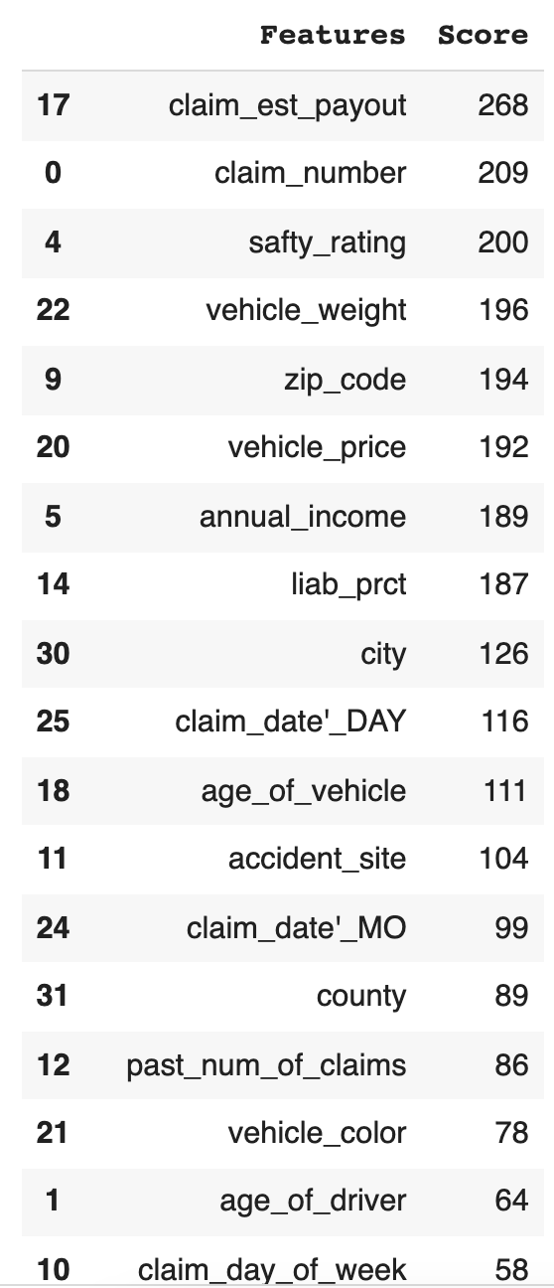
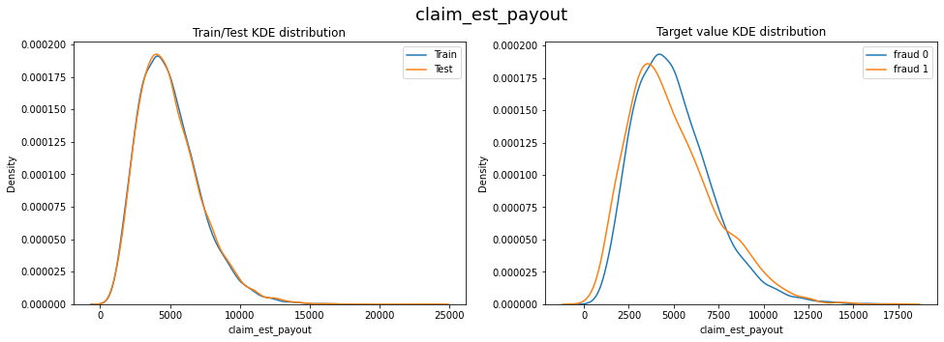
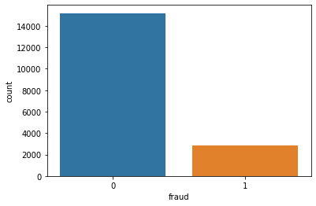
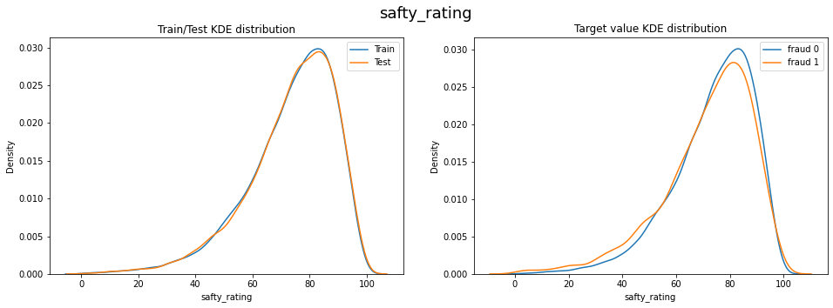
You can also split your content
Preliminary EDA
The data is skewed.
The distribution between fraud and non-fraud are almost same

Slide 6
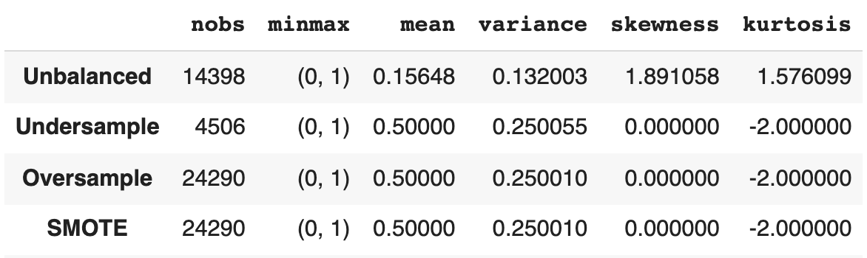
You can also split your content
Sampling methods
After using random over sampling, LGBM results beats the benchmark (XGBoost) score
IsolationForest does not perform well using sampling methods, the best f1 score is 0.209
Sampling
Result
Sampling method | f1 Score
Random Over Sampling | 0.379
Random Under Sampling | 0.365
SMOTE | 0.167

Slide 7
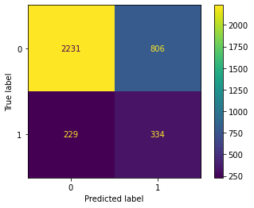
You can also split your content
Voting & Stacking methods
LGBM + XGBoost (tuned hyperparameter) with soft voting based on random over sampling tweak the f1 score to 0.392 (train) and 0.396(test)
Models | Soft Voting(f1 score) | Hard Voting(f1 score)
LGBM+XGBoost+CatBoost | 0.384 | 0.381
LGBM+XGBoost | 0.385 | 0.375
LGBM+XGBoost (Hyperparameter tuned) | 0.392 | -
Models | Stacking(f1 score)
LGBM+XGBoost (Hyperparameter tuned) | 0.378
LGBM+XGBoost+MLP (Hyperparameter tuned) | 0.202

Slide 8
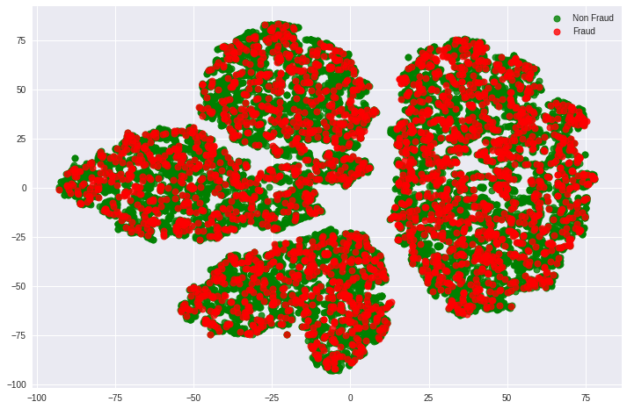
You can also split your content
Feature Engineering
Extract holiday from datetime features
Extract State, County, City from zip code
Compared income with median income from driver’ state, bin drives’ income
Compute vehicle income ratio (vehicle price / drivers’ income)
Frequency count for categorical features
Feature combinations + (mean/median, std, calculation)
T-SNE
There is no improvement from above feature engineering
Holiday | Fraud rate | Total counts
Christmas | 0.27027 | 37
Martin Luther King Jr. | 0.219512 | 41
Thanksgiving | 0.208333 | 48
July 4th | 0.2 | 45
Memorial Day | 0.195652 | 46
Labor Day | 0.183673 | 49
New Years Day | 0.163636 | 55
Columbus Day | 0.16 | 50
Workday | 0.156063 | 17525
Veterans Day | 0.089286 | 56
Presidents Day | 0.065217 | 46

Slide 9
You can also split your content
Feature Selection
Detect less information features
Features with only 1 unique value
Features with more than 90% missing values
Features with the top value appears more than 90% of the time
Covariate shift: use single feature to predict train or test data, if roc_auc is around 0.5, there is no covariate shift between train and test data
Feature importance
RFE
There is no improvement from above feature selection

Slide 10
You can also split your content
Discussion
Model: try deep learning models
Feature Engineering: domain knowledge to help for feature engineering
Data:
Customer historical credit data (if have)
Customer segmentation: occupation, education, income, location, etc (if not have 1)
Car type in model level (accidents rate)
More detail in witness indicator, such as relationship with drivers (cheating)
Third party inspection report
Video records

Slide 11
Thank you! Any question?

Slide 12
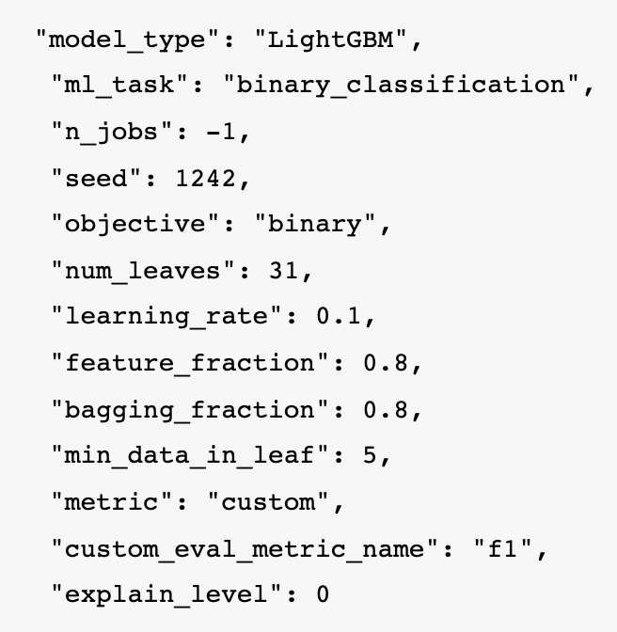
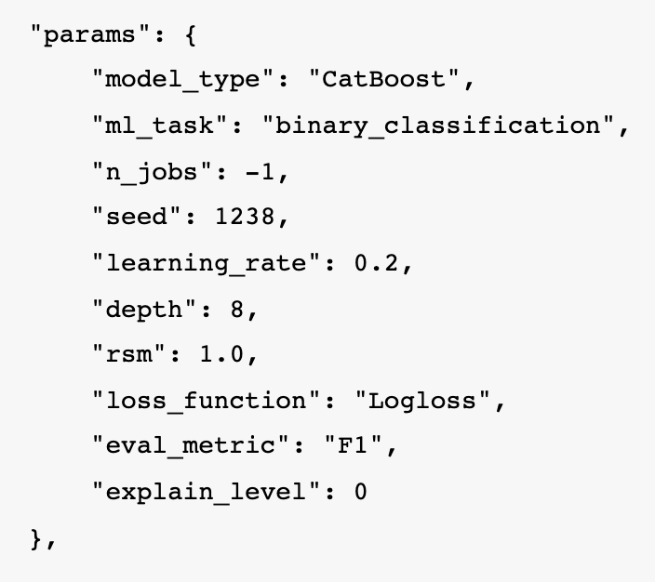
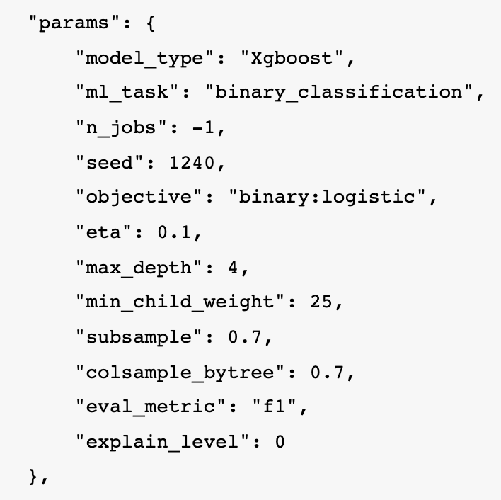
You can also split your content
Appendix: Models Tuning
Use AutoML(mljar-supervised) for three models hyperparameter tuning:

